Slide 1
Difference between
Verilog & system Verilog

Slide 2
Verilog
Verilog is a Hardware Description Language (HDL) used for RTL design and modeling digital circuits.
Developed by Gateway Design Automation, 1984
Notes:
It allows engineers to describe digital circuits like counters, adders, multiplexers, etc., at the RTL level.

Slide 3
System verilog
SystemVerilog is a HDL and HVL and an extension of Verilog that adds powerful features for both design and verification.
Introduced in 2002.
Notes:
It doesn’t replace Verilog; it adds more power to it.

Slide 4
Purpose of Each Language
Verilog
Focuses on describing hardware behavior and structure.
Suitable for RTL coding and simple testbenches.
SystemVerilog
Combines HDL + HVL (Hardware Verification Language).
Designed for complex SoC development.
Enhances both design clarity and verification capabilities.

Slide 5
Data Type Differences
Verilog
Limited types: reg, wire, integer, real.
No OOP.
Less strict regarding coding style.
SystemVerilog
New types: logic, bit, int, byte, enum, struct, union, string.
Supports dynamic arrays and associative arrays.
Strong typing reduces coding errors.
Adds OOP support (classes, inheritance, polymorphism).
Notes:
Data types decide how we store information in hardware code.
Verilog’s types are old and limited.
Inheritance is like family traits: a new class (child) gets properties and abilities from an existing class (parent), promoting code reuse
Polymorphism means "many forms": it allows objects from different classes (like Dog, Cat) to use the same method name (sound()) but each performs it differently (bark, meow), enabling flexible, unified handling.

Slide 6
Design Features
Verilog
Uses basic always blocks for all processes.
Does not differentiate between sequential and combinational logic.
SystemVerilog
Introduces
  always_ff → Sequential logic
  always_comb → Combinational logic
  always_latch → Latch modeling
Supports interfaces for clean module connectivity.
Provides packed/unpacked arrays for structured design.
Notes:
Combinational circuits produce outputs based only on current inputs (no memory)
sequential circuits use memory (like flip-flops) to factor in past states, synchronized by a clock

Slide 7
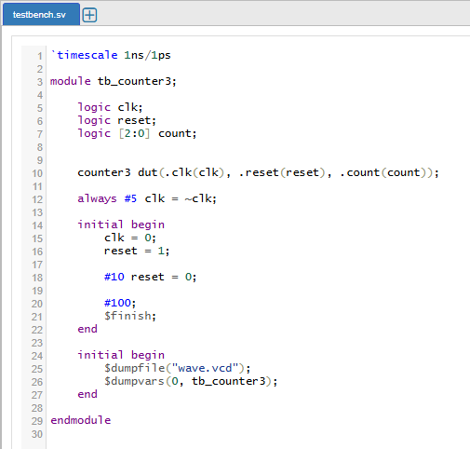
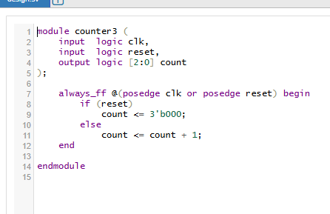
Examples through code
SystemVerilog

Slide 8
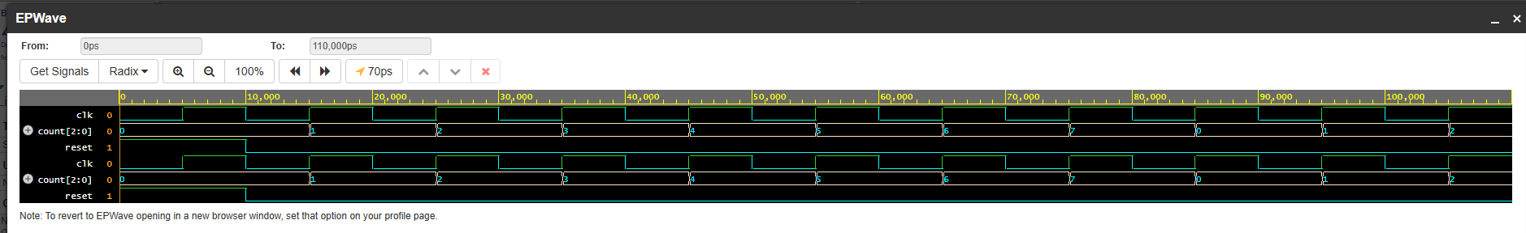
Output waveform

Slide 9
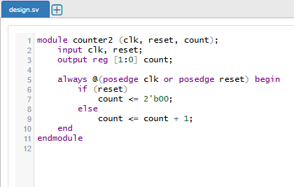
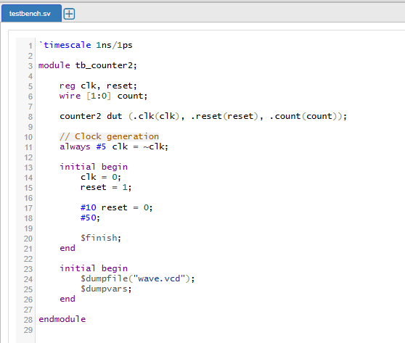
Examples through code
Verilog

Slide 10
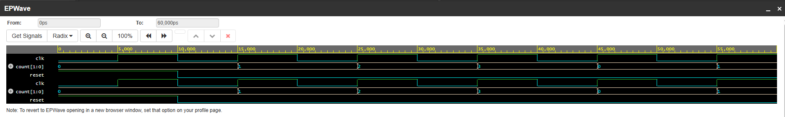
Output waveform

Slide 11
Verification Features
Verification features are the special tools, techniques, and language constructs used to check whether a digital design works correctly before fabrication
SystemVerilog provides advanced verification features that Verilog lacks:
Assertions (SVA) → Check design behavior automatically.
Randomization → Random test data generation.
Constraints → Control valid ranges of random data.
OOP testbench → Supports classes, inheritance, polymorphism.
Functional coverage → Measures how much of the design is tested.
Interfaces → Better connection management.
Mailboxes & Semaphores → Synchronization in testbenches.
These make SystemVerilog the standard for UVM-based verification.
Notes:
Verification takes 70% of total chip development time — that is why SystemVerilog shines here
Assertions (SVA)
Automatically check if a condition is always true.
Example:
"If ready signal goes high, valid must go high within 1 cycle."
Randomization
Generates random test values → helps find corner-case bugs.
Constraints
Control the randomization:
"Generate a value between 0 and 100."
OOP-Based Testbench
Testbenches become:
Modular
Reusable
Scalable
Easier to debug
Functional Coverage
Measures how much of the design behavior has been tested.
Ensures you don’t miss rare conditions.
Interfaces
Reduce wiring errors by grouping signals.
Mailboxes & Semaphores
Used for synchronization inside testbenches.
.

Slide 12
Summary & Conclusion
Verilog is mainly for hardware design.
SystemVerilog extends Verilog with better design constructs and powerful verification features.
SystemVerilog is the industry standard for modern chip verification and UVM environments.
SystemVerilog improves testbench quality, design clarity, and debugging efficiency.

